Slide 1
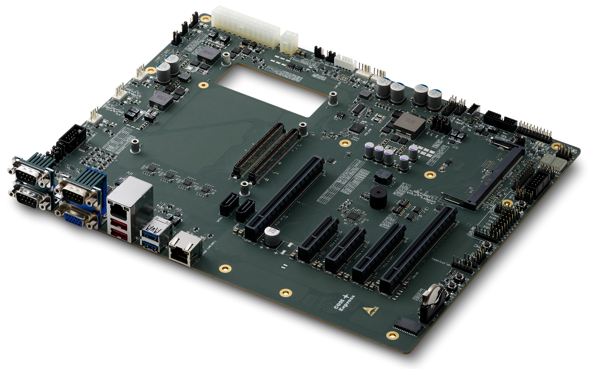

Slide 4
COM Express Type 7 (2x 220 pins)
4x USB 3.x upgrade
2x PCIe
10G-KR
CEI mode
10G-KR
CEI mode
10G-KR
CEI mode
10G-KR
CEI mode
PCIe x16
12V
CD
AB
eSPI / LPC
2x SATA
2x PCIe
PCIe clock &
2nd PCIe clock
4x USB 2.0
2x
PCIe
6x PCIe
4x PCIe
NC-SI
SPI
5Vsb
12V
GbE
Control & Miscellaneous
Serial

Slide 5
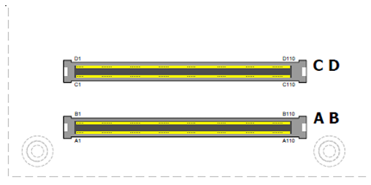
Signals and Pinout for
COM Express Type 7
D1
D110
C1
C110
B1
B110
A1
A110

Slide 7
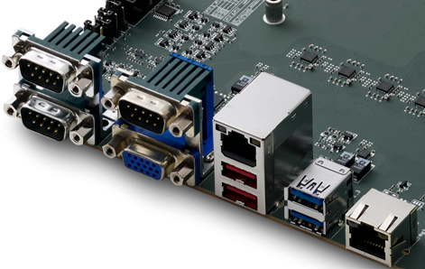
LAN
Mgt. LAN

Slide 8
USB1 (top)
USB0 (bottom)
USB3 (top, from hub)
USB2 (bottom)

Slide 11
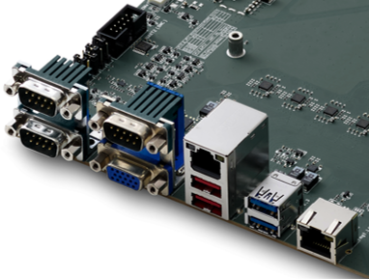
UART2
COM0 (top, SER0)
COM1 (bottom, SER1)
UART1 (top)

Slide 12
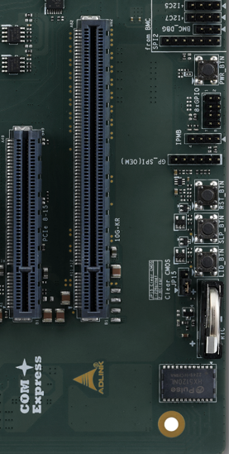
LID_BTN
SLP_BTN
RST_BTN
PWR_BTN

Slide 13
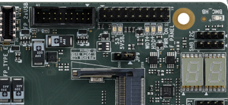
S3 5VSB WDT+ HDD+ PWR_ON
BMC_LED
PORT 80

Slide 14
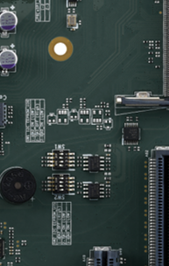
S3 5VSB WDT+ HDD+ PWR_ON
BMC_LED
U75
U36

Slide 15
